Slide 2

Bringing Big Data Analytics through Apache Spark to .NET
Brigit Murtaugh
Program Manager
@BrigitMurtaugh
Notes:
Bringing Big Data Analytics through Apache Spark to .NET

Slide 3
What is Apache Spark?

Slide 4
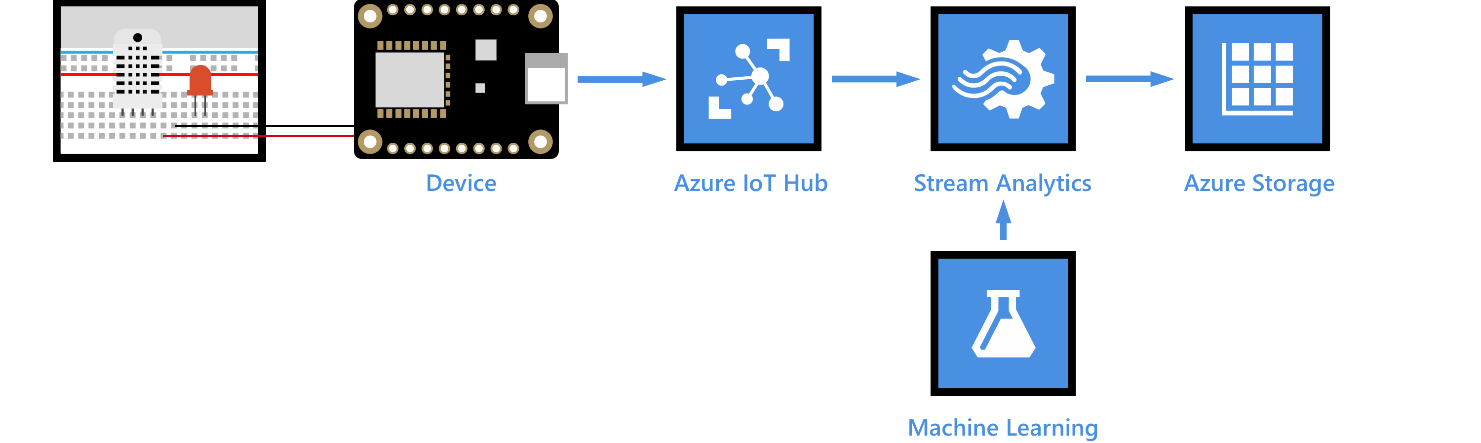
Big Data
Volume, velocity, and variety of data
Thousands of IoT sensors in a factory, producing petabytes of data

Slide 5
How can we process it all?

Slide 6
How can we process it all quickly and efficiently?

Slide 7


Slide 8
What is Apache Spark?
General-purpose distributed processing engine for analytics over large datasets

Slide 9
A few things you can do with Apache Spark
Spark SQL
Spark Streaming
Machine Learning

Slide 10
1
2
3

Slide 11
Driver
2
Spark Session
User’s Program
3

Slide 12
Driver
Executors
Spark Session
Task 1
Task 2
User’s Program
Task 3
Task 4
3

Slide 13
Driver
Executors
Spark Session
Task 1
Task 2
User’s Program
Task 3
Task 4
Cluster Manager

Slide 14
How can I use Apache Spark?

Slide 15



How can I use Apache Spark?
Popular Spark APIs in languages like:

Slide 16
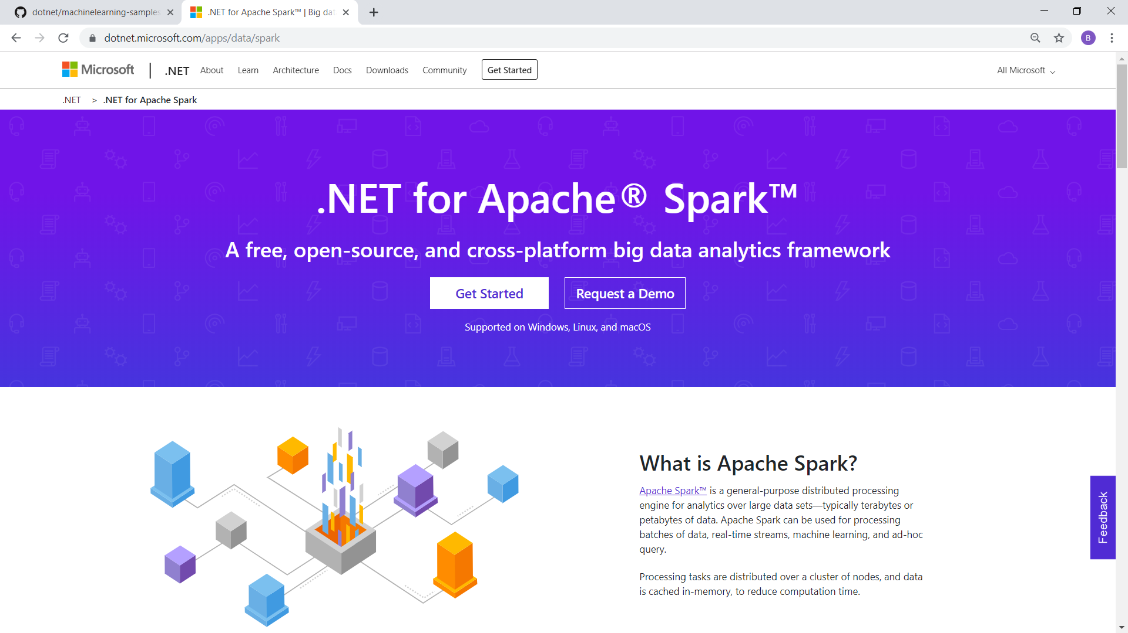


Slide 17

.NET for Apache Spark
A free, open-source, and cross-platform big data analytics framework
Re-use knowledge, skills, code you have as a .NET developer
Designed for high-performance

Slide 18
Goal: .NET for Apache Spark is aimed at providing .NET developers a first-class experience when working with Apache Spark.

Slide 19
Customer Success: MSAI
Microsoft Search, Assistant & Intelligence Team: Towards Modern Workspaces in O365
Job:
Build ML/Deep models on top of substrate data to infuse intelligence to Office 365 products
Data resides in ADLS, in turn gets fed into our ML models
Why .NET Spark?
Business logic (featurizers, tokenizers for normalizing text) are written in C# – Spark.NET is an ideal candidate for our workloads
Leverage Spark.NET to run those libraries at scale
Experience:
Very promising, stable & highly vibrant community that is helping us iterate at the agility we want. Looking forward to longer working relationship and broader adoption across Substrate Intelligence / MSAI.
Scale: ~ 50 TB
Notes:
“Spark.Net team helped enhance the user experience which was a major issue for adoption in Satori”
Write cook/featurize data that in turn gets fed into our ML models.

Slide 20
Spark Scenario: Batch Processing

Slide 21
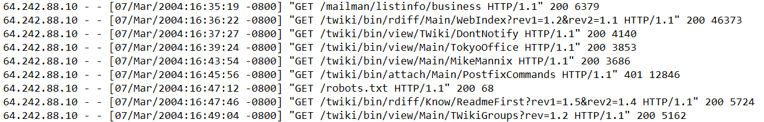
Batch Processing
Working with data that’s already stored, such as:
Log processing
Data warehousing

Slide 22
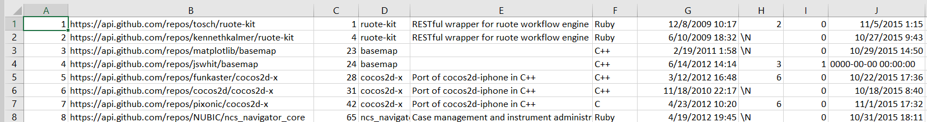
Batch Processing: Example
GitHub projects data
On average, how many forks does each language have?

Slide 23
Batch Processing Demo
Notes:
C:\Users\brmurtau\batch

Slide 24
Spark Scenario: Machine Learning + Big Data

Slide 25

ML + Apache Spark
ML + big data to scale training and prediction of ML algorithms
Use ML.NET: a free, cross-platform, open source ML framework

Slide 26
ML + Apache Spark: Example
Sentiment analysis:
Given a set of online reviews, which are positive and which are negative?
"I love .NET for Apache Spark!"
"I hate running inefficient big data queries!"

Slide 27
Sentiment Analysis Demo
Notes:
C:\Users\brmurtau\source\repos\modelbuilderspark
C:\Users\brmurtau\source\repos\modelbuilderspark\modelbuilderspark

Slide 28
Spark Scenario: Structured Streaming

Slide 29
Structured Streaming
Live data (coming from a sensor, phone, network)
Uses micro-batch processing
Batch 1
Batch 1
Batch 2
Batch 3
Batch 4
Batch 2
Batch 3
Batch 4
Batch 5
Batch 6
Batch 5
Batch 6

Slide 30
Structured Streaming: Example
Live sentiment analysis
Type string into console, determine if positive or negative in real-time

Slide 31
Structured Streaming Demo
Notes:
source/repos/modelbuilderstream/modelbuilderstream
C:\Users\brmurtau\source\repos\modelbuilderstream\modelbuilderstream

Slide 32
How can I get started?

Slide 33
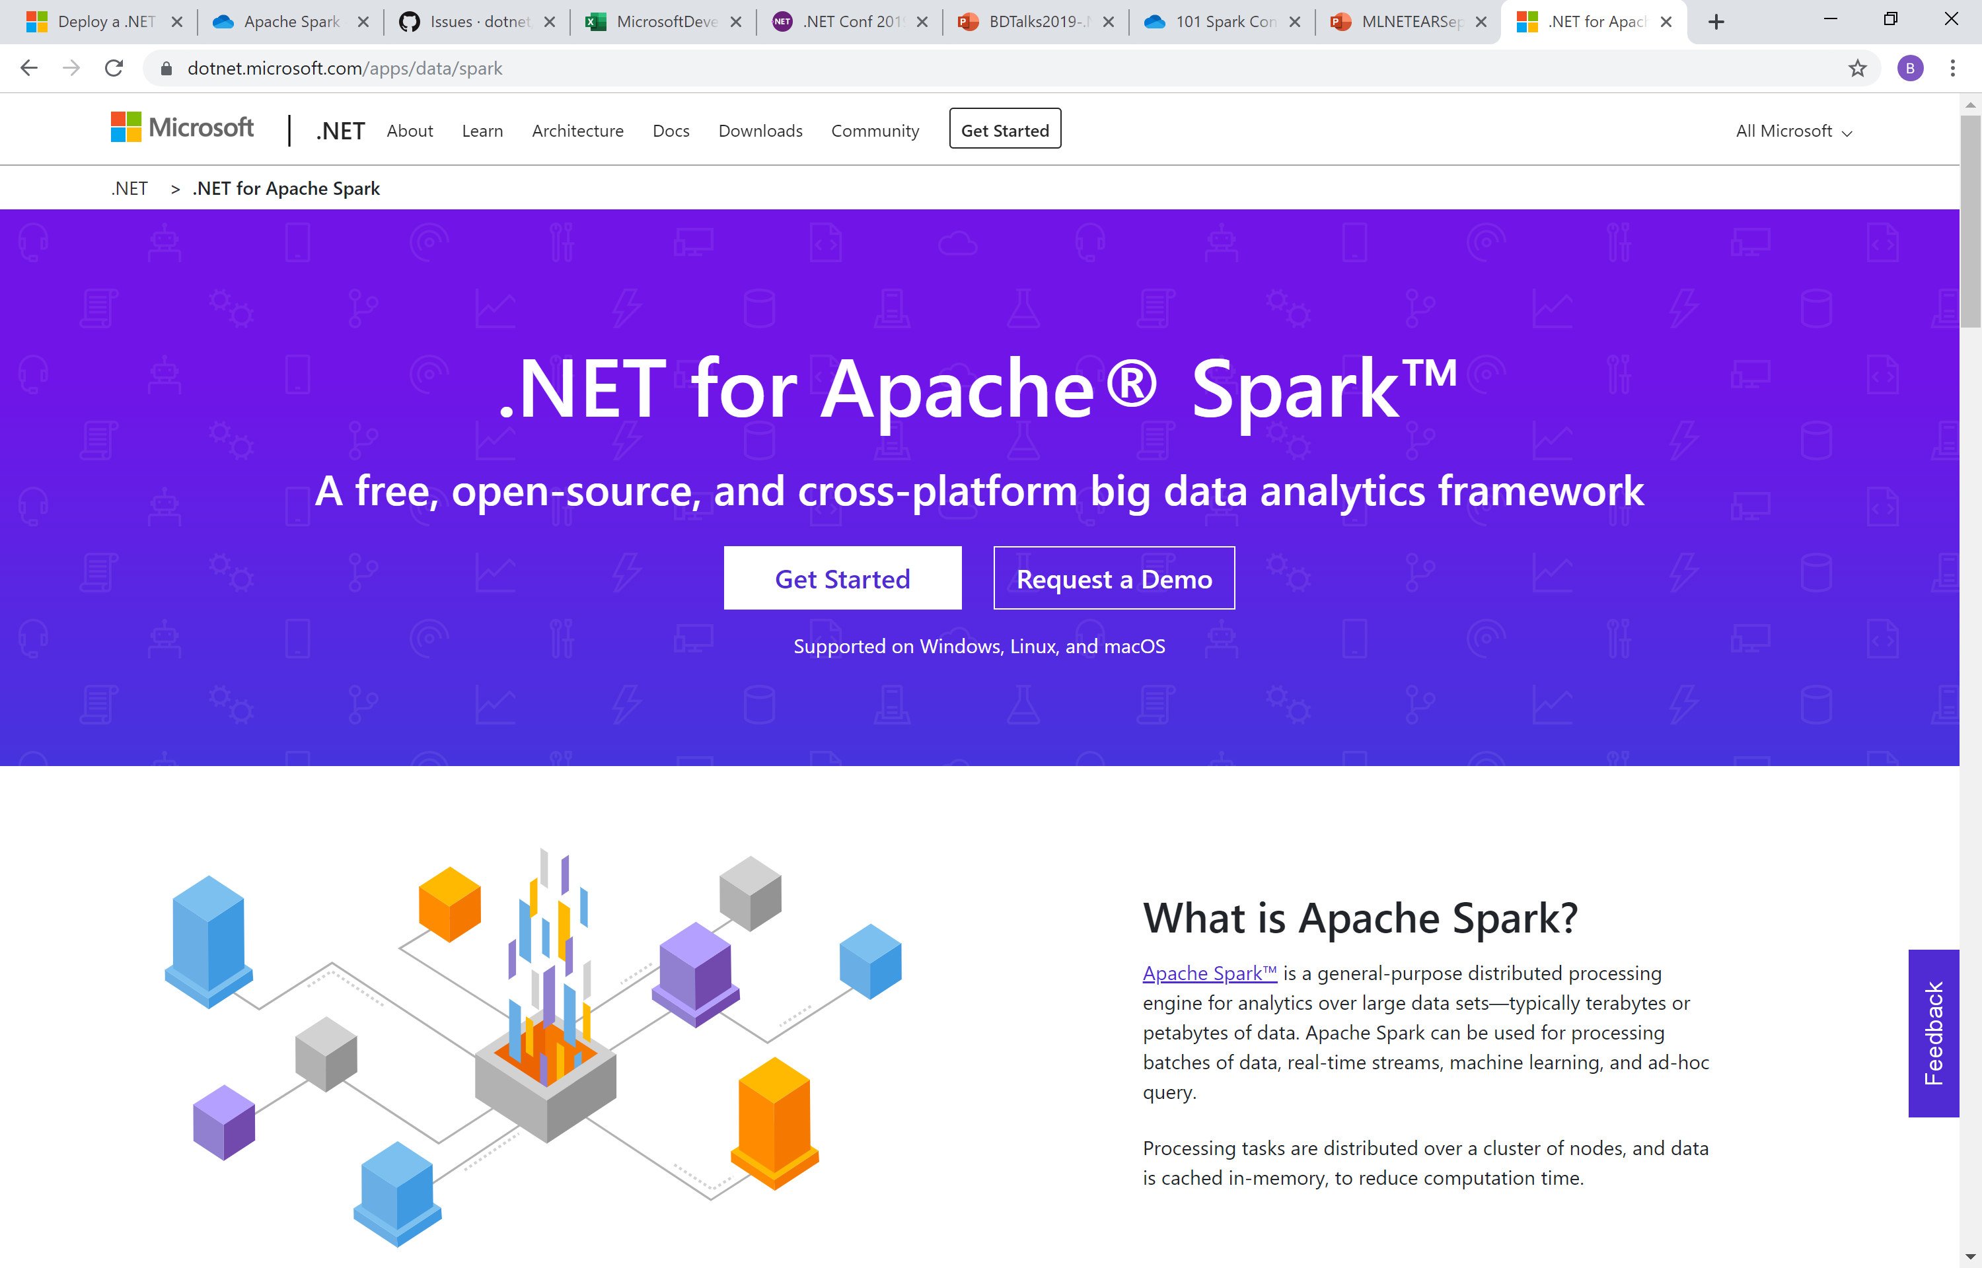
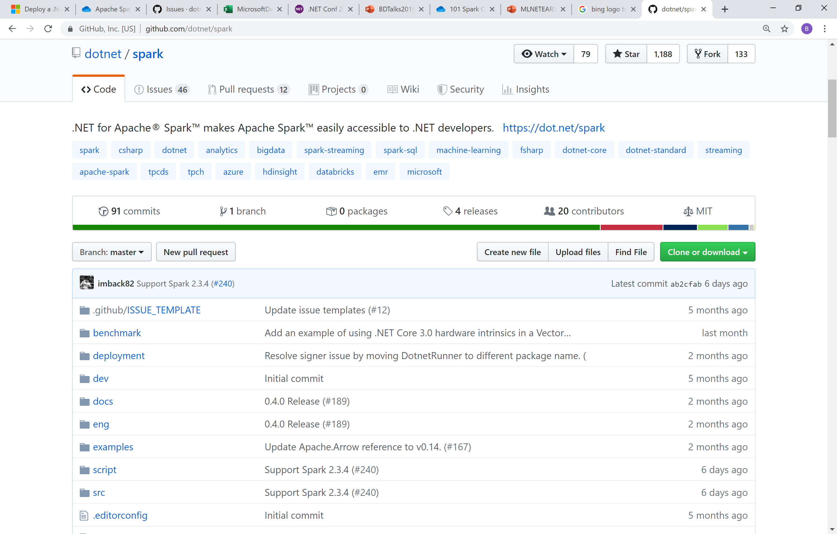
Ways to get involved
https://dot.net/spark
github.com/dotnet/spark

Slide 34
Thank you!
Brigit Murtaugh
Program Manager
@BrigitMurtaugh

